Slide 1
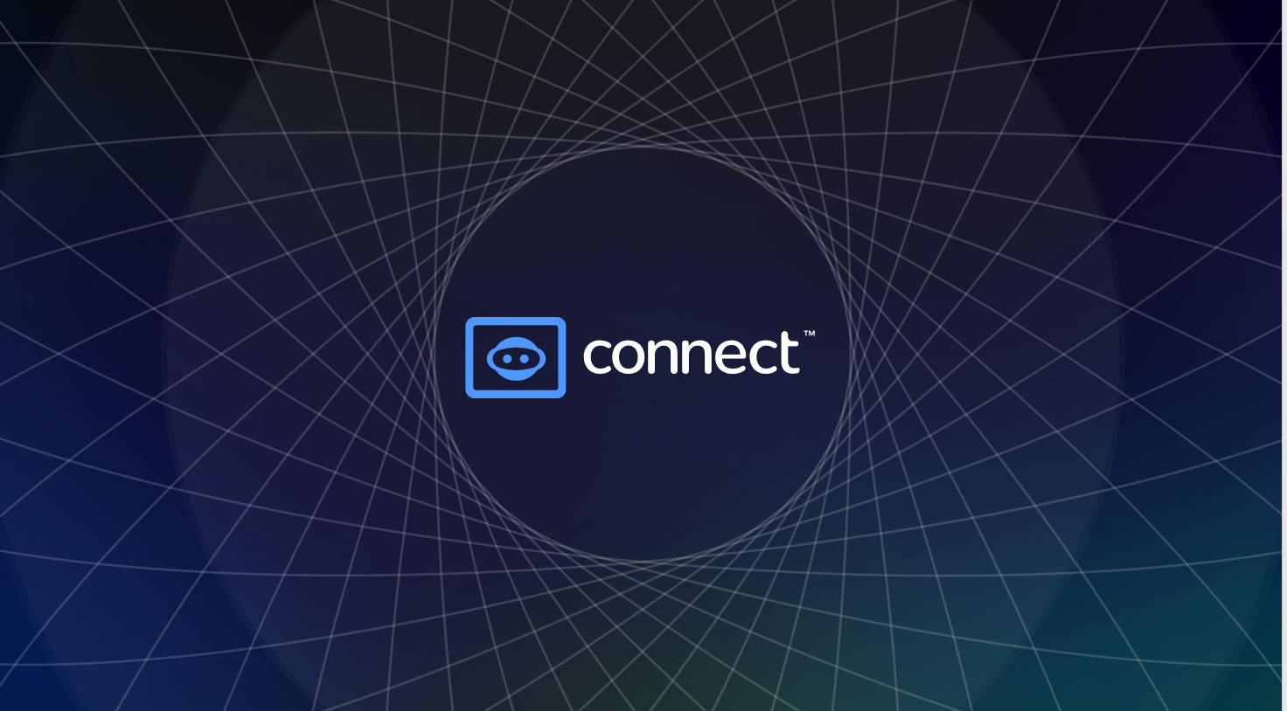

Maximizing Your Engagement and Security on Social Media and Blockchain Platforms
TEAM TRAINING

Slide 2
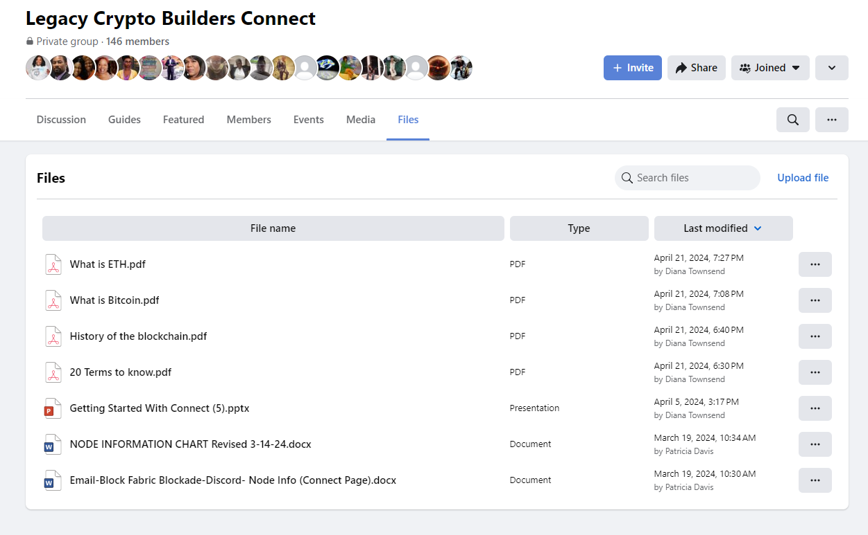
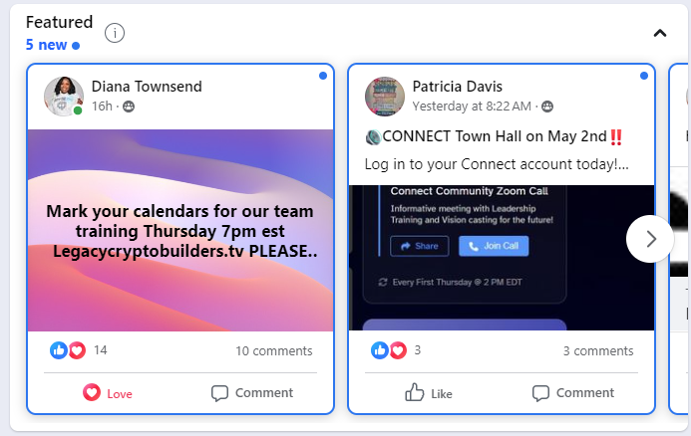
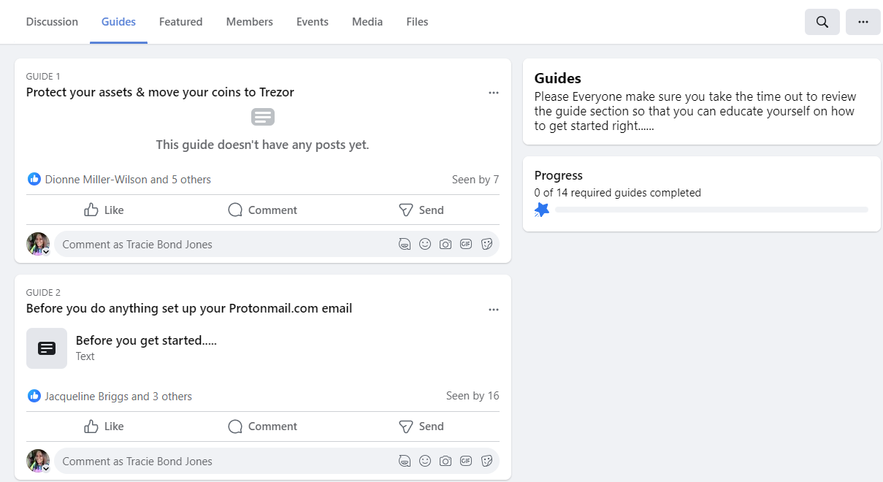
Legacy Crypto Builders Connect Facebook page:
https://www.facebook.com/groups/legacycryptobuildersconnect
Utilize and explore files
Featured Section
Provides guidance
Encourage your team to view
Latest information
Easy to download
Have anything to share?
  Easy to upload
FILES:
https://www.facebook.com/groups/legacycryptobuildersconnect/files/files
GUIDES:
https://www.facebook.com/groups/legacycryptobuildersconnect/learning_content

Slide 3

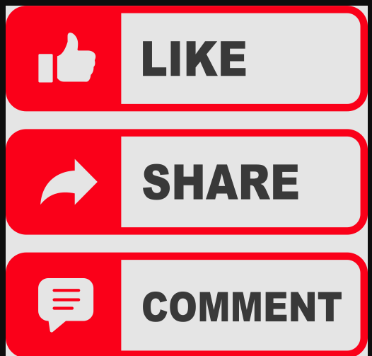
Active Engagement:
Let’s be sure we SUPPORT each other on social media! It is important to actively engage in your team’s content.
Like
Share
Comment
DON’T JUST VIEW AND SCROLL! ENGAGE!

Slide 4
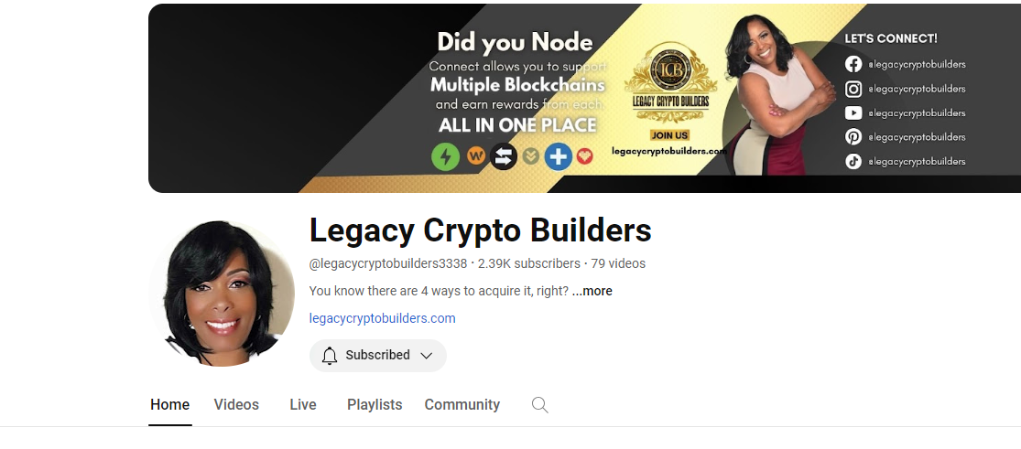

Subscribe on Youtube
Subscribe to Legacy Crypto Builders on YouTube
  https://www.youtube.com/@legacycryptobuilders3338
Updates and Important Information

Slide 5
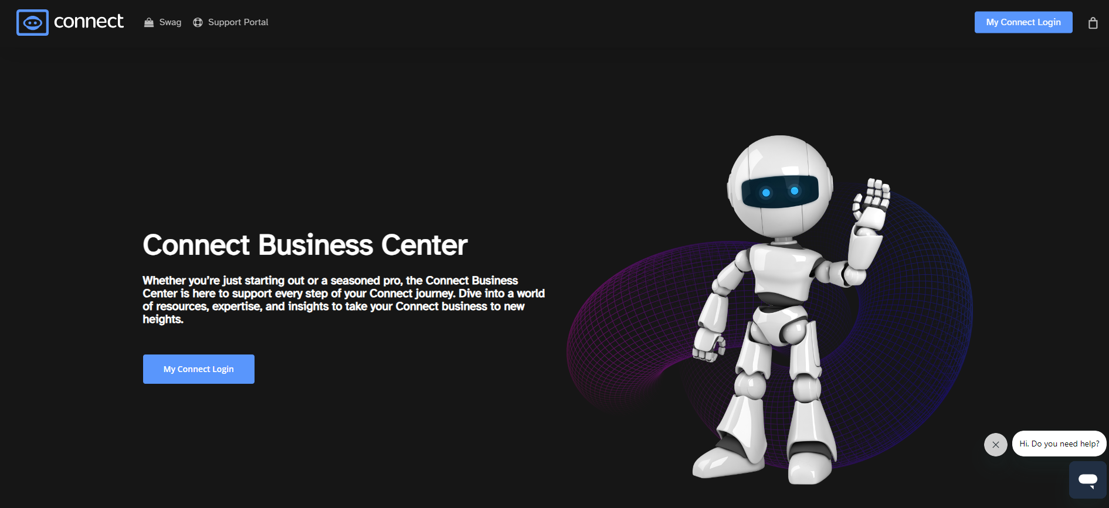
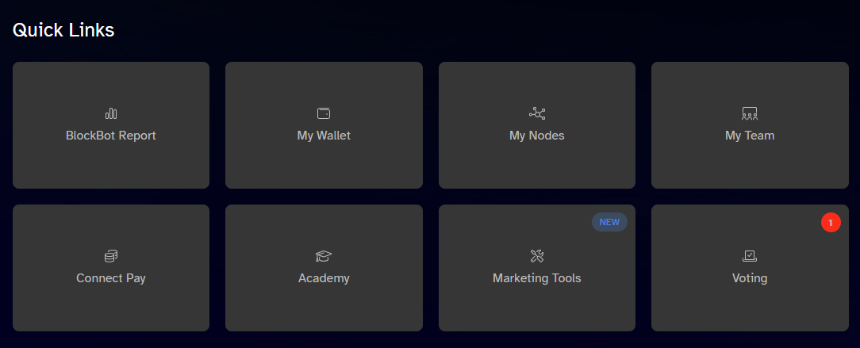
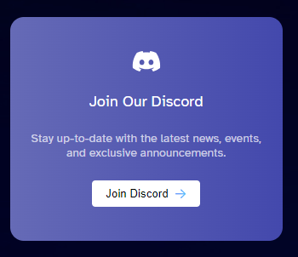
CONNECT.WIN
Connect Business Center:
Dashboard
Quick Links
  BlockBot Report
  My Wallet
  My Nodes
  My Team
  Connect Pay
  Academy
  Marketing Tools
  Voting
My Connect
  Academy
  Buy Nodes
  Node Setup
  Share Link
Discord
  Support
  Interaction
FAQ section
  Common queries

Slide 6
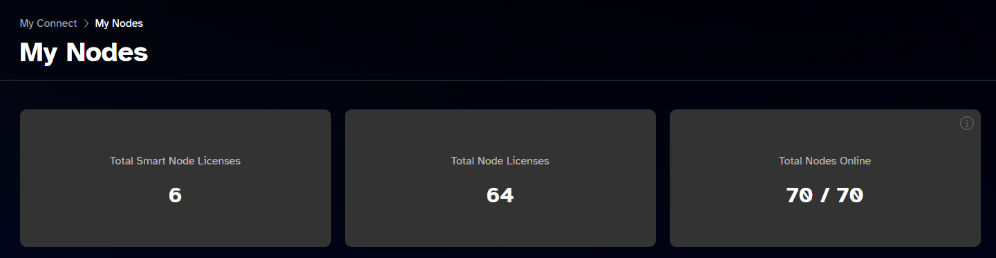
Log into your Connect account DAILY!
Check Dashboard/My Nodes to ensure nodes are online
Check the individual blockchain brand website to confirm nodes are running if your connect dashboard shows they are not running
Communicate with your leader if nodes are offline for more than 24 hours
BRAND WEBSITE URLs
Element – elementunited.com
Galvan – galvan.health
Give – giveblockchain.io
Green – setpowerfree.com
Grow – growunited.com
Hyper – nerdunited.com
Liberty – libertyblockchain.com
Pixll – uplevll.com
Switch – switchblackcard.com

Slide 7
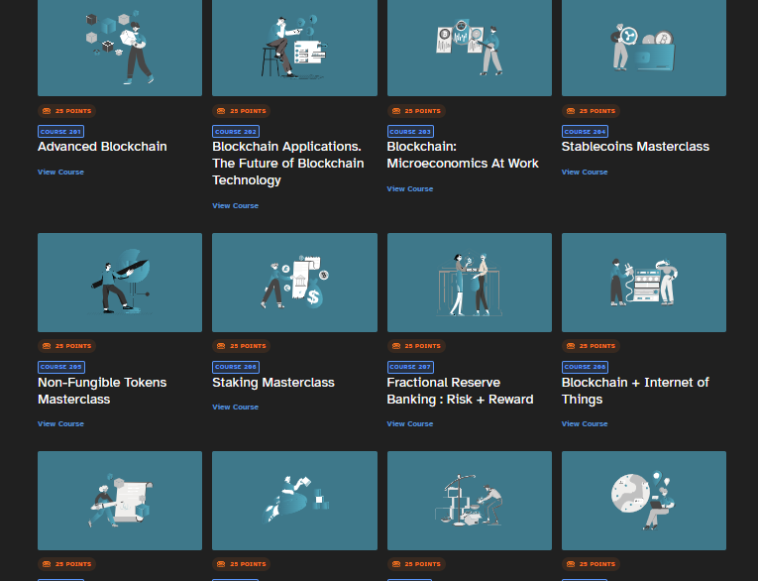
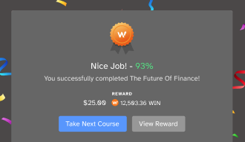
BLOCKCHAIN ACADEMY
Understand our Business Model
by completing the Blockchain Academy courses:
New and Improved!
Timely participation!
Get WIN deposits upon completion!
https://web.connectunited.com/academy

Slide 8
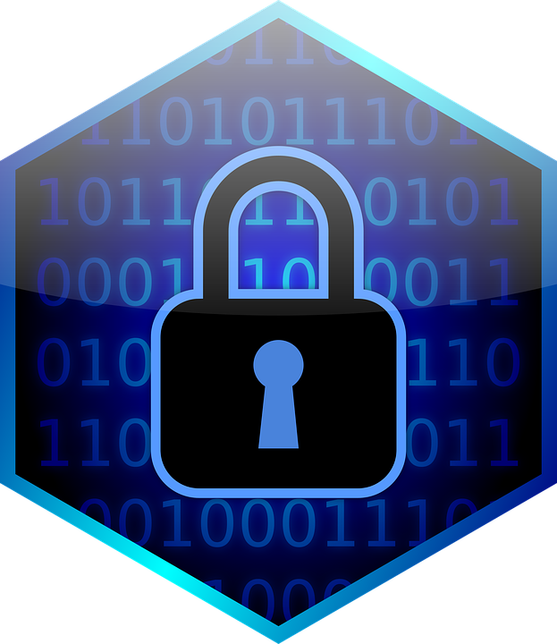
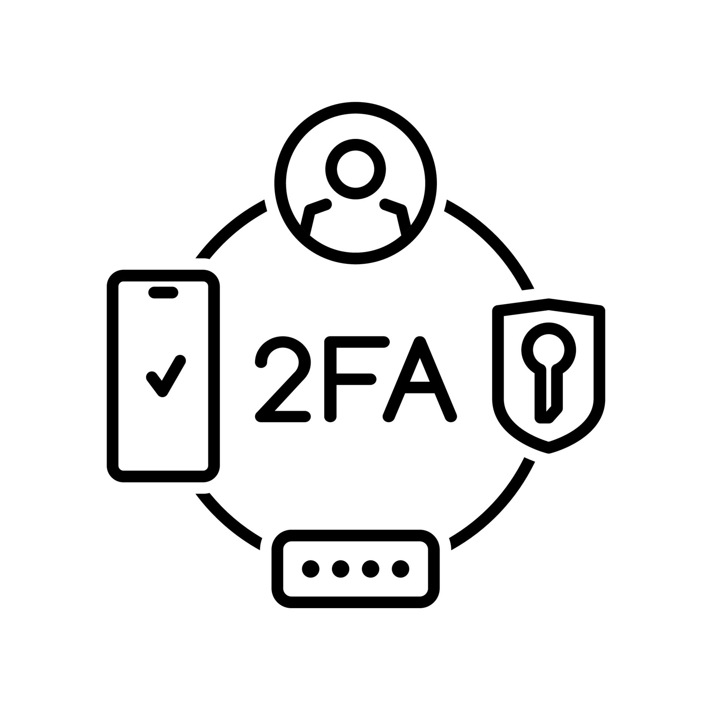
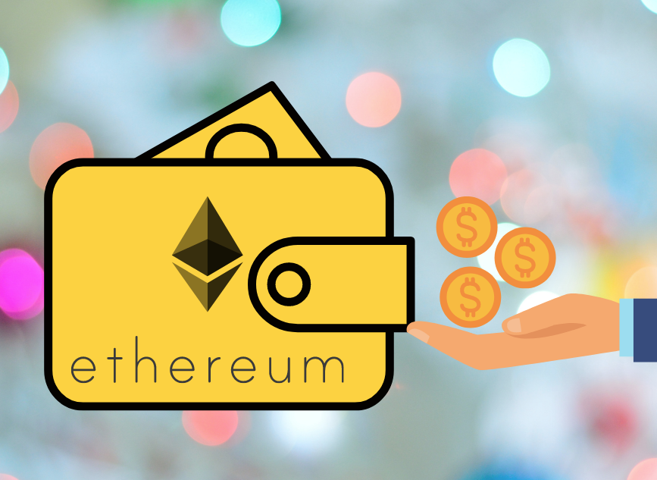
Secure Your Wallet &
Backup Security
Must set up wallet before turning on Node
  Use Blockfabric - https://www.nodeengine.io/
  Vultr is an alternative - https://www.vultr.com/
Enable 2FA for extra security
  2 separate devices
Use separate passwords for login and wallet encryption
Ensure ETH in wallet for withdrawals
Never give out your SEND wallet address
Verify wallet addresses before transactions
  1st 5 digits and last 5 digits
Create second set of passwords and encryption passcodes
  Keep offsite for added security
  Never take a picture of your 12-word recovery phrase

Slide 9
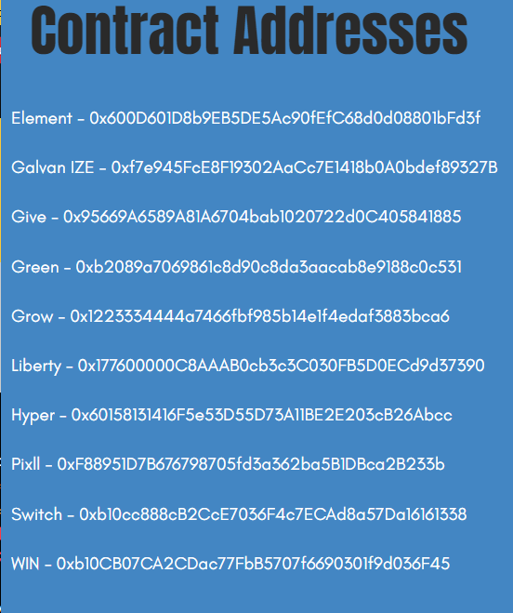

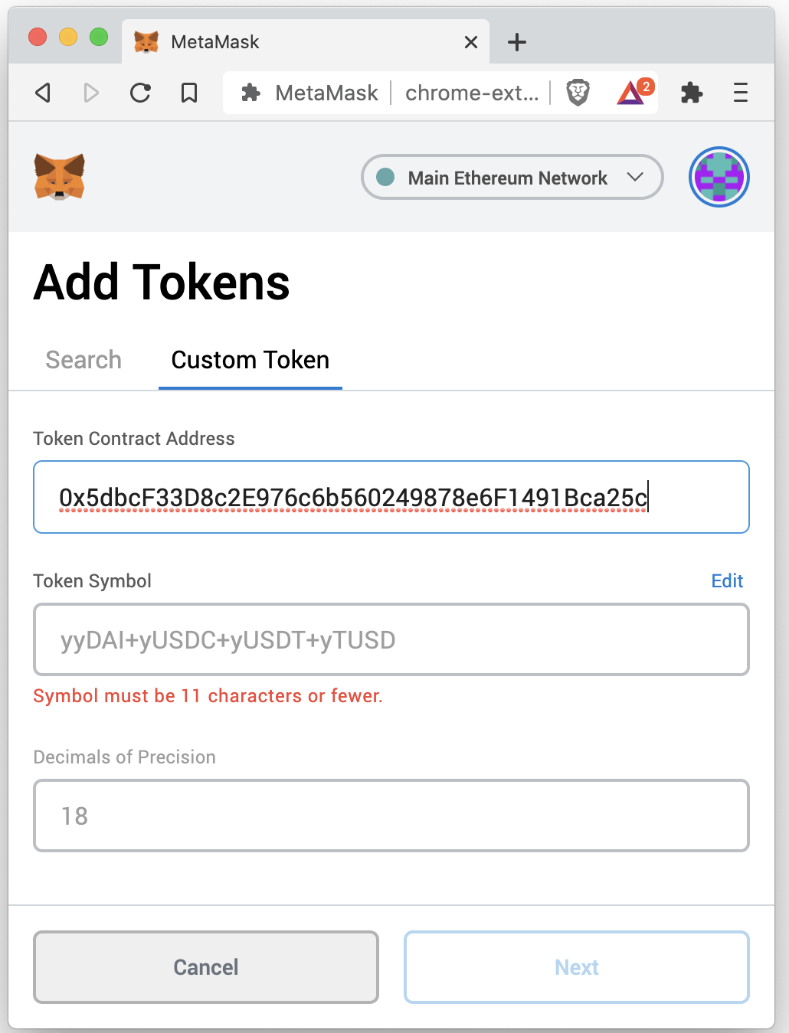
Monitor Blockchain Rewards
Add contract addresses to MetaMask
Allows interaction with decentralized applications
Open your in-browser MetaMask extension (or mobile app) and log into your account. Click Add Token at the bottom of the extension view. Under Custom Token, type in the Token Contract Address for the issuer token and you can then proceed to add the token listing to your wallet view.

Slide 10

Communication
Zoom Etiquette
  Make sure legal name is displayed before joining (on all devices)
  Be on time
  Mute your device
  Minimize distractions
  Silence your phone
  No eating on video
  Raise your hand to speak
  Use chat feature for questions/comments
  Stay focused and attentive

Slide 11
Important Links
Legacy Crypto Builders - https://www.legacycryptobuilders.com/
LCB Zoom - https://legacycryptobuilders.tv/
Zendesk - https://support.connectunited.com/hc/en-us
Connect United – https://connect.win/
Connect Community Call Zoom - https://us06web.zoom.us/webinar/register/1217066401542/WN_eH3utlIlTgGyW4a_IkJMIw
Discord - https://discord.com
Virtual Private Server – Block Fabric - https://www.nodeengine.io/

Slide 12


