Slide 1
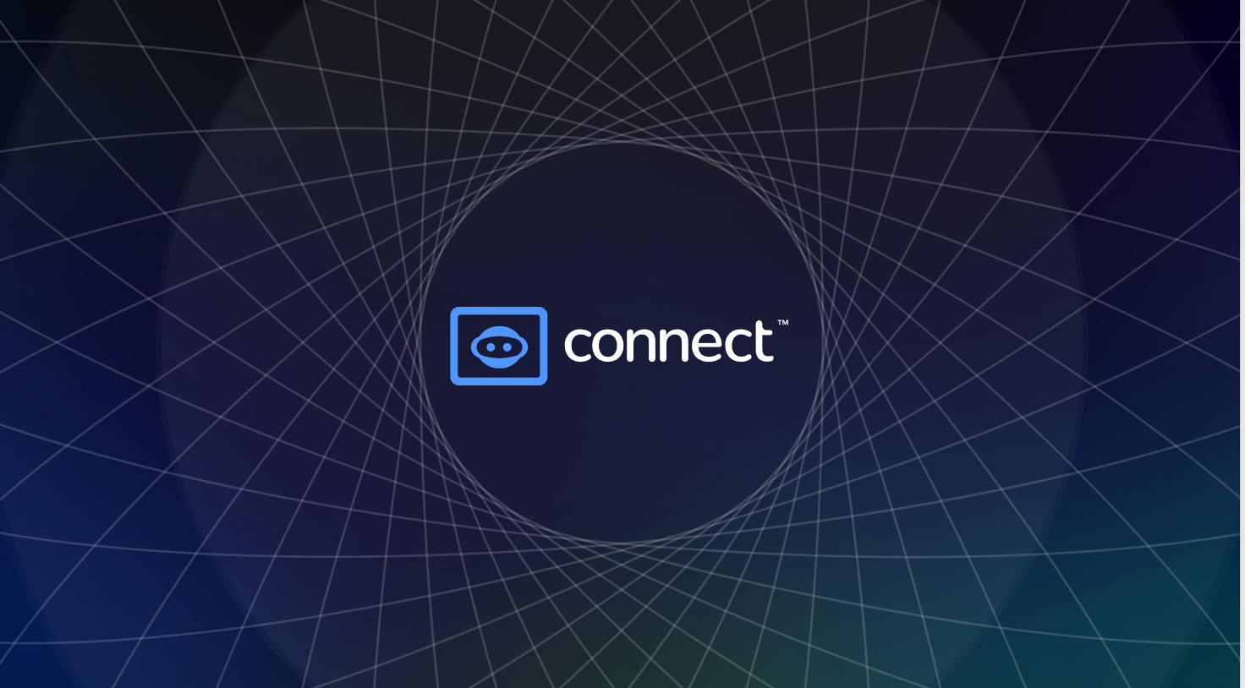
GETTING STARTED WITH CONNECT

Slide 2
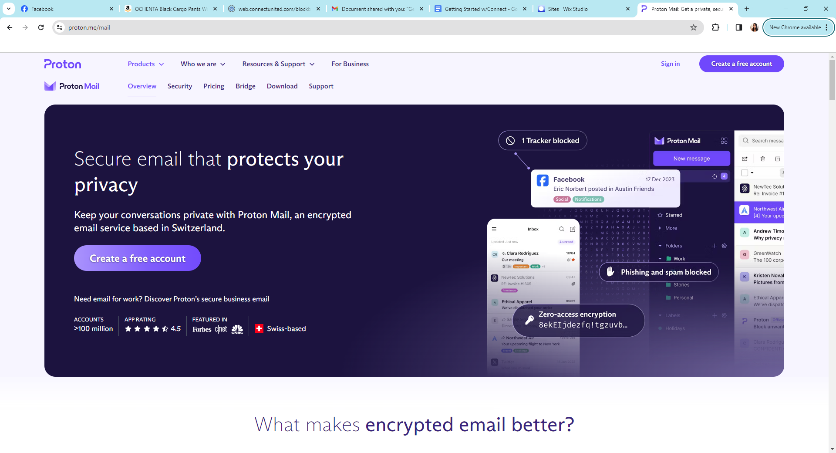
STEP 1: Secure Your Encrypted PROTON Email.
Go to https://proton.me/mail and set up a PROTON FREE email account. (This is a cryptocurrency email). This will secure your crypto asset messages. Use it for EVERYTHING you do in the Connect United/Block Fabric blockchain/crypto space. Make sure you go to your app store and download PROTON Mail on your phone so you can access your email from your cell phone.

Slide 3
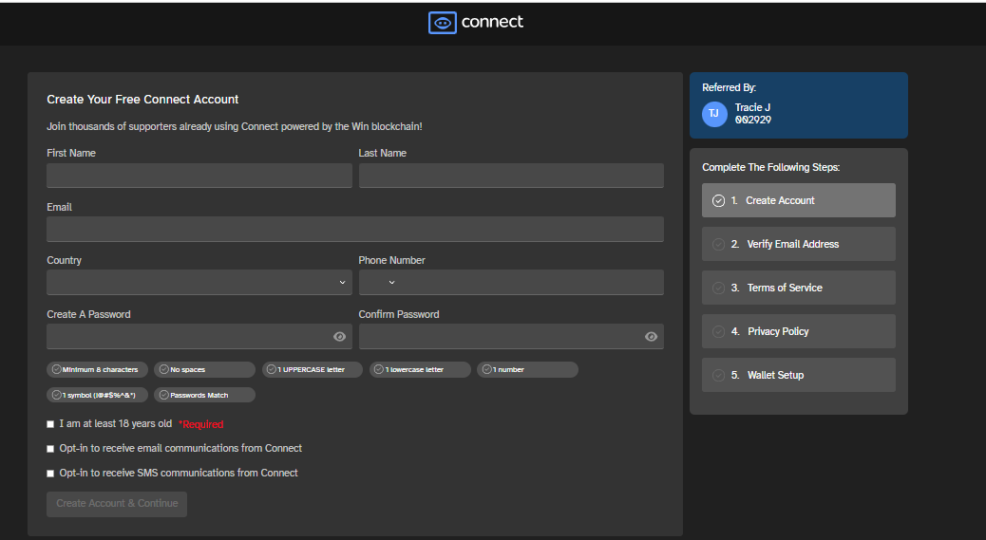
STEP 2: Enroll Using Your Sponsor’s Link.
Once you have created your encrypted email, ask the person who referred you to the platform for their sign-up link. Then, click on the link and CONFIRM your sponsor's name on the right-hand side of the page BEFORE you enroll.
Once you enroll it will prompt you to verify your email. Log into your newly created PROTON email and verify your email. Once that is done, it will allow you to continue to the create your wallet.

Slide 4
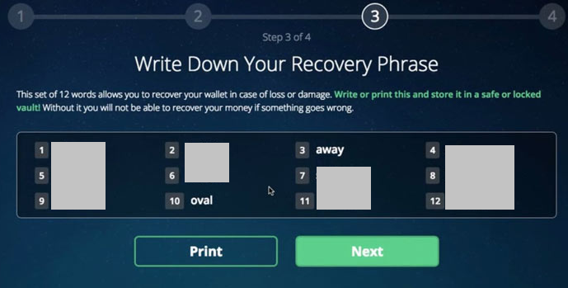
STEP 3: Create Your Wallet.
You will be prompted to create an ENCRYPTION password. This password should be something you have NEVER used before. It is something you MUST hold onto it is equivalent to the pin# you use it on your bank's debit card. So, make sure you DO NOT use the same word/phrase that you use to log into the account and use something you have never used before. If you lose this word/phrase you will NEVER be able to withdraw your rewards out of this account. Next you will need to write down your 12-word recovery phrase that shows up on the screen.
Write down all 12-word recovery phrase in order, on the next screen it will ask you to type in the 12 words to verify that you have secured the recovery phrase. All the words are in lower case. Once the wallet has been created, click continue.

Slide 5
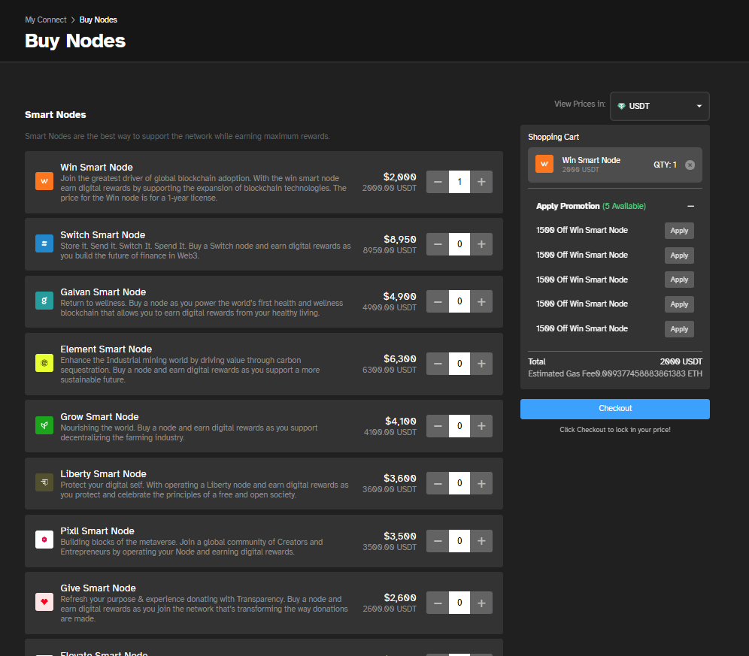
STEP 4: Purchase Node(s)
Go to Buy Nodes and select node to purchase. If you have any available Promotions, you will see it under “Apply Promotion” Then proceed to check out.

Slide 6
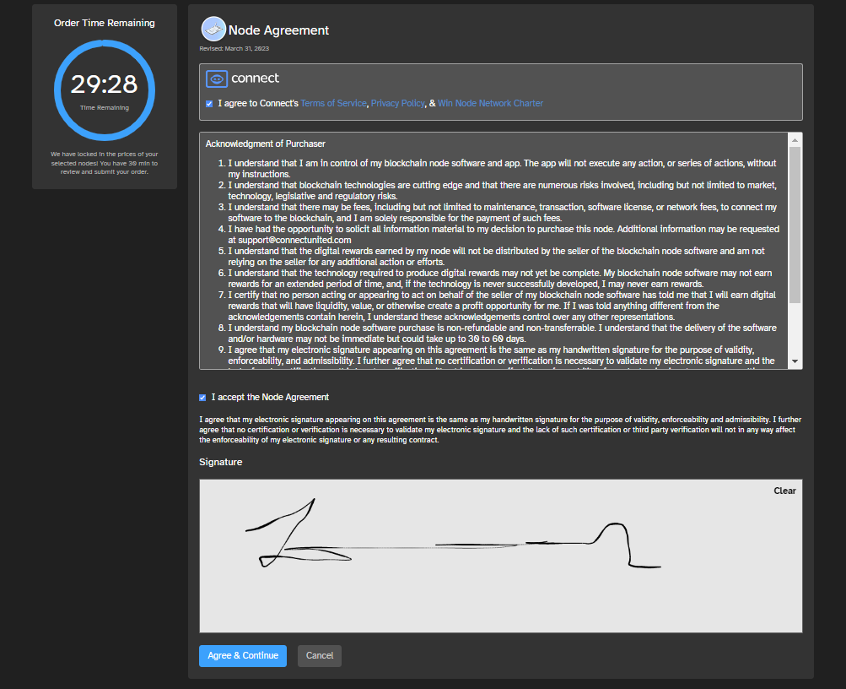
STEP 5: Click Agree and Sign
Check both boxes that you agree and add your signature. Click Agree & Continue.

Slide 7
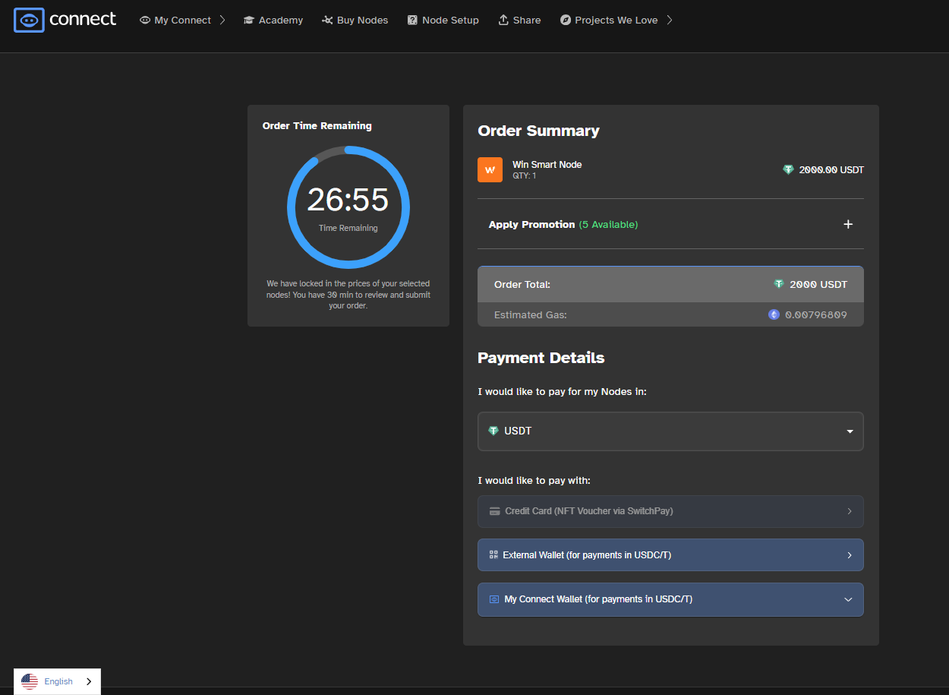
STEP 6: Select Payment
Click on USDT to see all options to pay for your Node. Select option. Then click on an option under “I would like to pay with:”

Slide 8
STEP 7: SUBMIT Payment
Once you have entered all your information click submit payment.
If your payment is declined you may need to call your bank, sometimes they may send a text or email to confirm there is no fraud on the account. Once you have contacted them and confirmed there is no fraud hit retry payment or you may need to enter the information again for the sale to go through.
YOU HAVE 30 MINUTES TO COMPLETE PAYMENT.
Once the sale has started processing a blue box will appear that says:
“Redeem Node License Voucher”
Click on that box and DO NOT TOUCH ANYTHING let the order process until it gets to a screen that says, “You’re so close to earning rewards.”

Slide 9
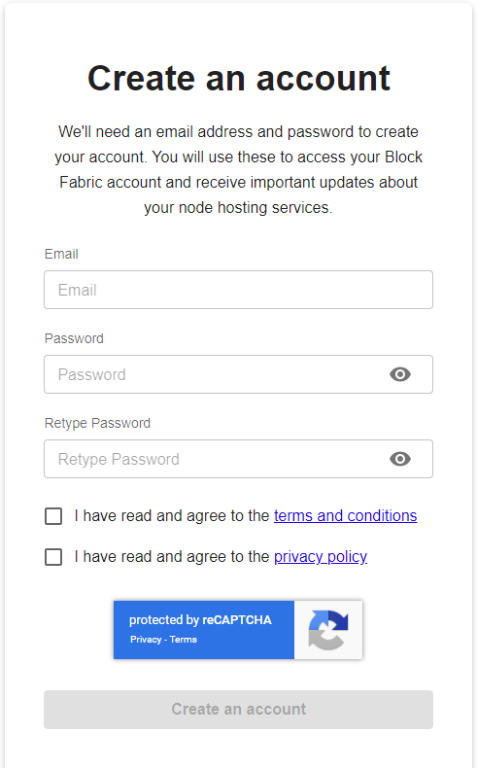
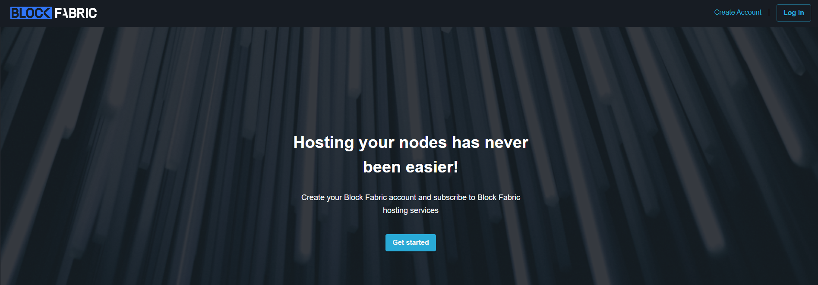
STEP 8: Create Your VPS account
In another window, GO TO the link app.nodeengine.io
Block Fabric is our VPS that hosts our nodes.
Click on Create Account.
Use your PROTON email address and choose a password. Please DO NOT use your encryption password used during wallet creation! Check both term and conditions and private policy boxes. Click Create an account. You will need to verify your email address via https://proton.me/mail, then log into Block Fabric again. Once verified, you will be prompted to start hosting.

Slide 10
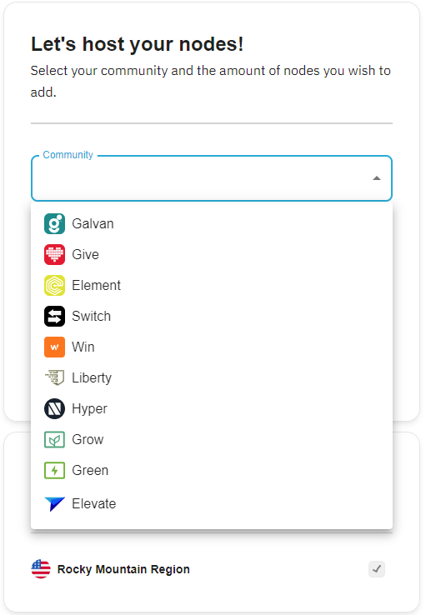
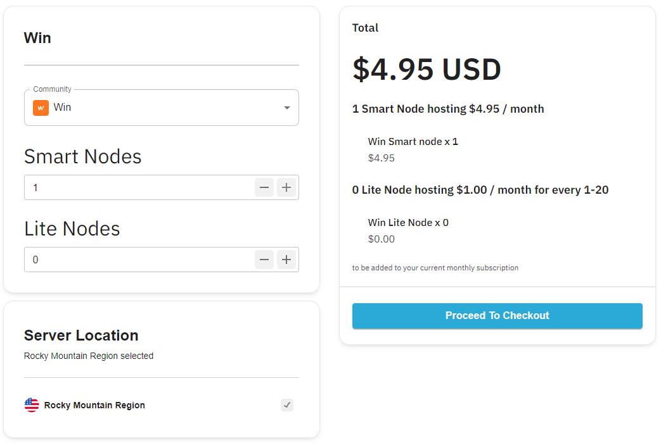
STEP 9: Turn On Your Node(s)
Click Add Instance. Click on community. Select the BLOCKCHAIN that represents the node that you purchased. Select the quantity that you purchased, then Proceed to Checkout. Input your credit card information that will be automatically billed every 30 days.

Slide 11
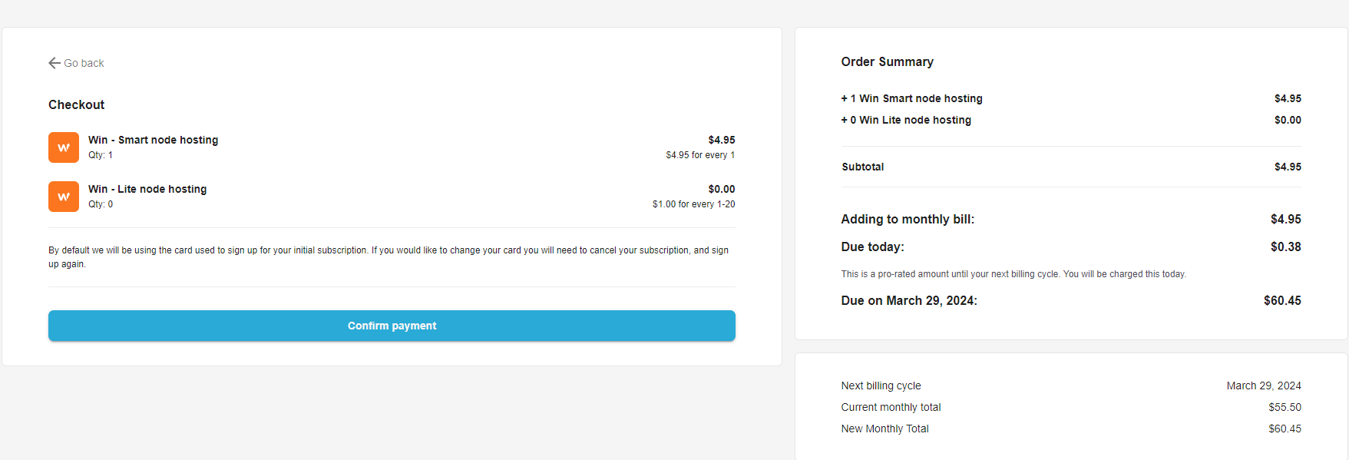
STEP 9: Turn On Your Node(s) cont’d
The price is $4.95 per node. Click Confirm payment. Once the payment has been confirmed, you will be prompted to enter your PROTON email address and password used for the blockchain you are turning on. Ex: If you purchased a WIN, use your PROTON email address and your WIN password. Leave Referral Code blank. Then click Deploy.

Slide 12
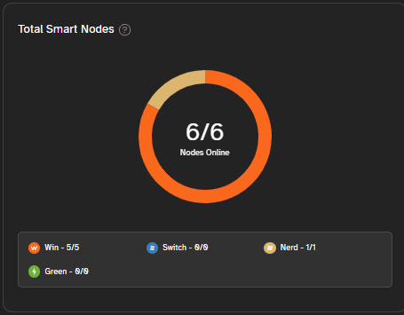
STEP 11: Verify Node(s) Online
Once it indicates that the node is online, you can log out of block fabric and go back to Connect United. https://web.connectunited.com/login
Click on My Connect, then scroll to Blockbot Report.

Slide 13
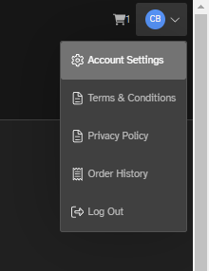
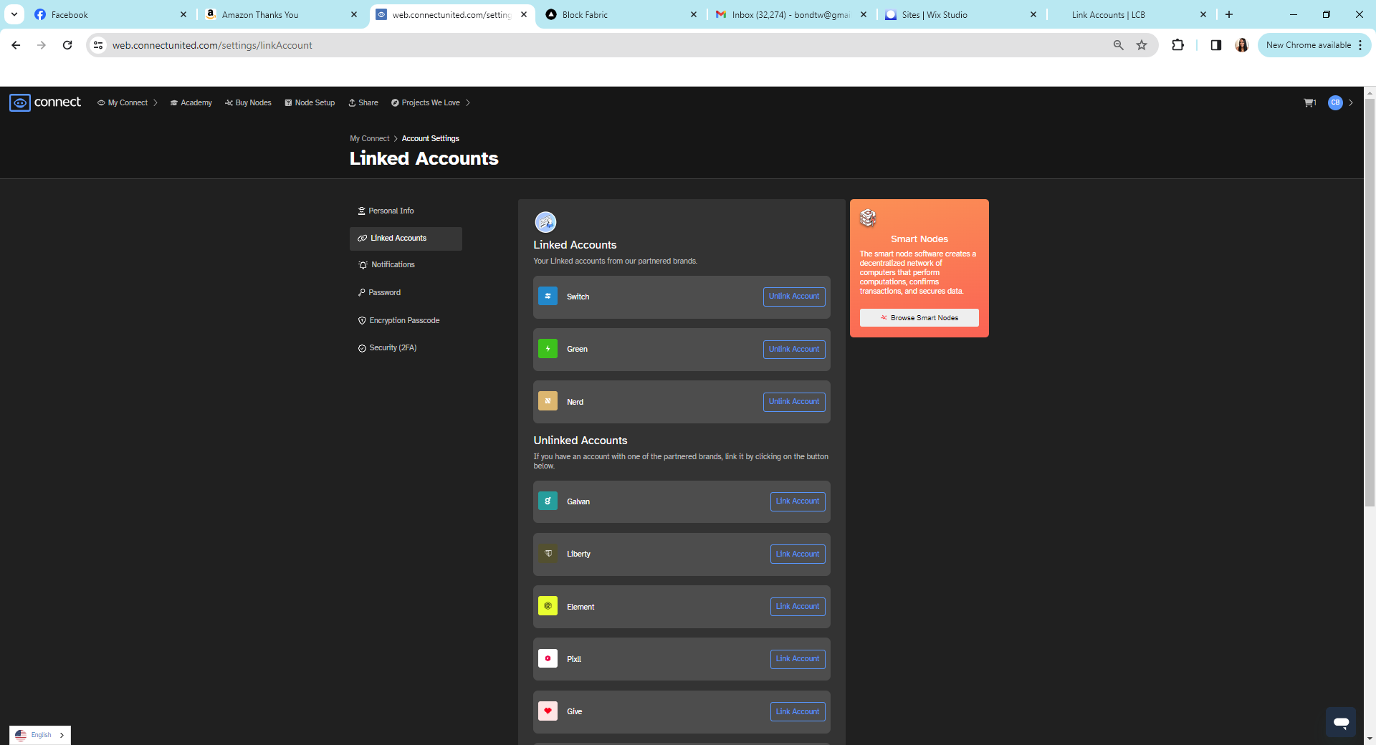
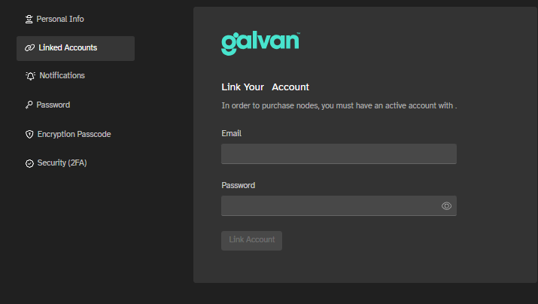
Step 12: Link Accounts
Depending on what type of smart node you buy, you need to make sure the node's brand account is linked within your Connect United account. PLEASE REMEMBER TO USE YOUR PROTONMAIL EMAIL FOR ACCOUNT CREATION!
Log into your Connect Account. Click on your initials in the top right-hand corner. Select Account Settings
Click on Linked Accounts. Select Link Account located under your purchased node brand.
Ex. Select Galvan. Log in using your Galvan credentials to link account.
Once linked, your account will move to your link Accounts category.
See below the list of brand accounts that you must create a login for when buying that specific node.
Green - setpowerfree.com
Switch - switchblackcard.com
Galvan - galvan.health
Give - giveblockchain.io
Liberty - libertyblockchain.com
Element - elementunited.com
Pixll - uplevll.com
Hyper - nerdunited.com

Slide 14
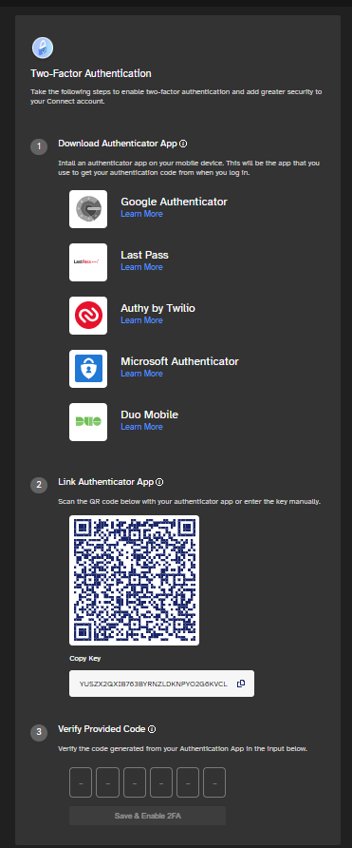
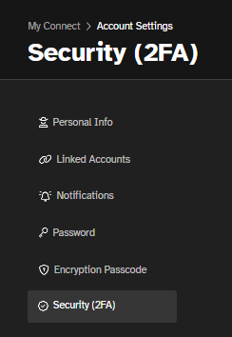
STEP 13: Setting up 2 Factor Authentication for WIN:
Log into your Connect Account. Click on your initials in the top right-hand corner. Select Account Settings.
Select
Security (2FA). Follow directions to set up.
DO NOT turn on your 2FA (2 Factor Authenticator) unless you are able to add it to two separate devices in case you lose or break one of the devices. You may set up 2FA for each blockchain where you own nodes, by logging into their respective links:
Green - setpowerfree.com
Switch - switchblackcard.com
Galvan - galvan.health
Give - giveblockchain.io
Liberty - libertyblockchain.com
Element - elementunited.com
Pixll - uplevll.com
Hyper - nerdunited.com

Slide 15
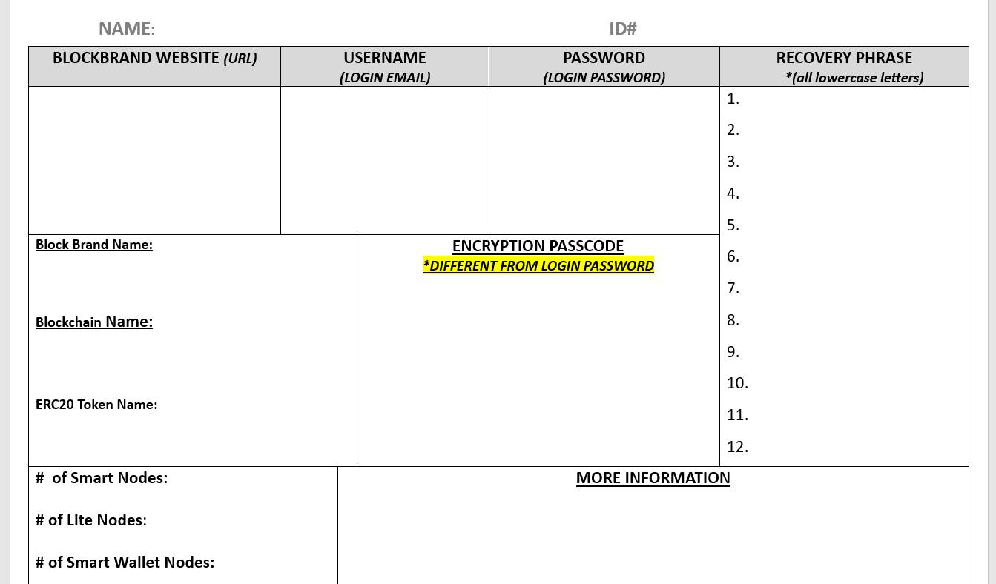
REMINDERS
Document your passwords for each blockchain, email address, and VPS (Block Fabric).
Document your 12-word phrases for each blockchain.
Document the website URLs for each blockchain you own a node for.
Store them in a safe location (fireproof safe, safe deposit box). Below are two organization documents to help you.
Blockchain 12-word phrases
Green |  |  | WIN |  |  | Pixll |  |  | Hyper (Nerd)
1 |  |  | 1 |  |  | 1 |  |  | 1
2 |  |  | 2 |  |  | 2 |  |  | 2
3 |  |  | 3 |  |  | 3 |  |  | 3
4 |  |  | 4 |  |  | 4 |  |  | 4
5 |  |  | 5 |  |  | 5 |  |  | 5
6 |  |  | 6 |  |  | 6 |  |  | 6
7 |  |  | 7 |  |  | 7 |  |  | 7
8 |  |  | 8 |  |  | 8 |  |  | 8
9 |  |  | 9 |  |  | 9 |  |  | 9
10 |  |  | 10 |  |  | 10 |  |  | 10
11 |  |  | 11 |  |  | 11 |  |  | 11
12 |  |  | 12 |  |  | 12 |  |  | 12
Switch |  |  | Galvan |  |  | Element |  |  | Give
1 |  |  | 1 |  |  | 1 |  |  | 1
2 |  |  | 2 |  |  | 2 |  |  | 2
3 |  |  | 3 |  |  | 3 |  |  | 3
4 |  |  | 4 |  |  | 4 |  |  | 4
5 |  |  | 5 |  |  | 5 |  |  | 5
6 |  |  | 6 |  |  | 6 |  |  | 6
7 |  |  | 7 |  |  | 7 |  |  | 7
8 |  |  | 8 |  |  | 8 |  |  | 8
9 |  |  | 9 |  |  | 9 |  |  | 9
10 |  |  | 10 |  |  | 10 |  |  | 10
11 |  |  | 11 |  |  | 11 |  |  | 11
12 |  |  | 12 |  |  | 12 |  |  | 12

